Slide 1
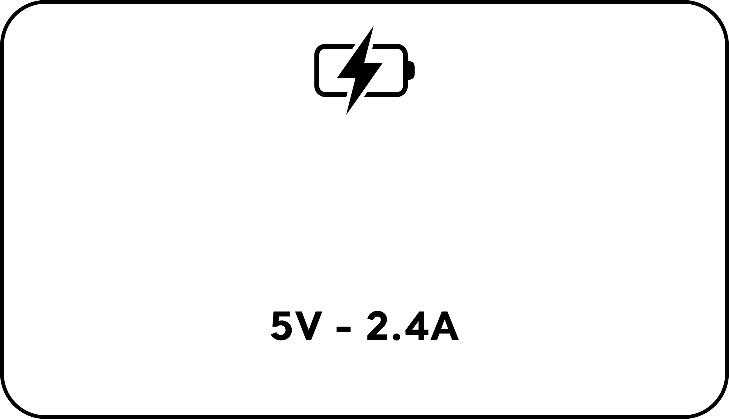
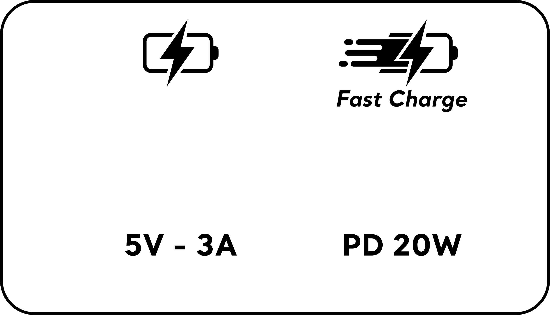
Charge standard 2.4A
Charge Rapide PD20W
12W Max
5V - 2.4A
PD3.0 20W Max
5V-3A, 9V-2.22A, 12V-1.66A
12W Max
5V - 2.4A
QC3.0 18W Max
5V-3A, 9V-2A, 12V-1.5A
12W Max.
Total 5V-2.4A Max
15W Max.
Total 5V-3A Max
PD: Power Delivery = Puissance delivrée
QC: Quick Charge = Charge rapide

